Slide 1
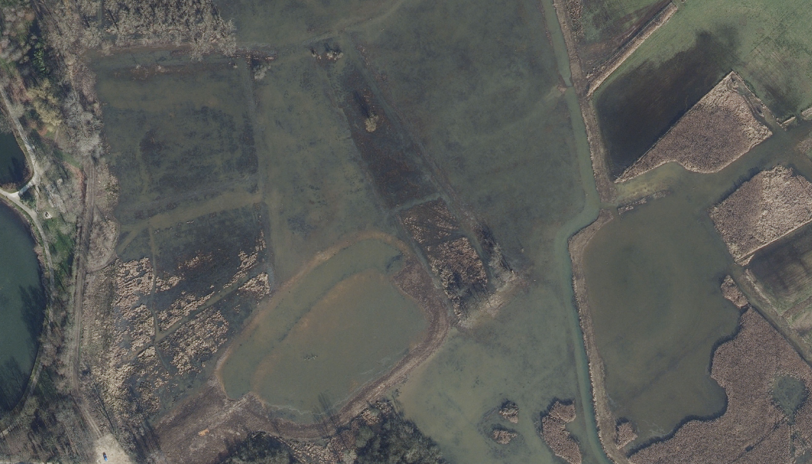
Inundation – Time Series
Workshop Flanders
Sebastiaan Verbesselt
Habitats pilot meeting - 10/06/2025 – Diest, Belgium

Slide 2
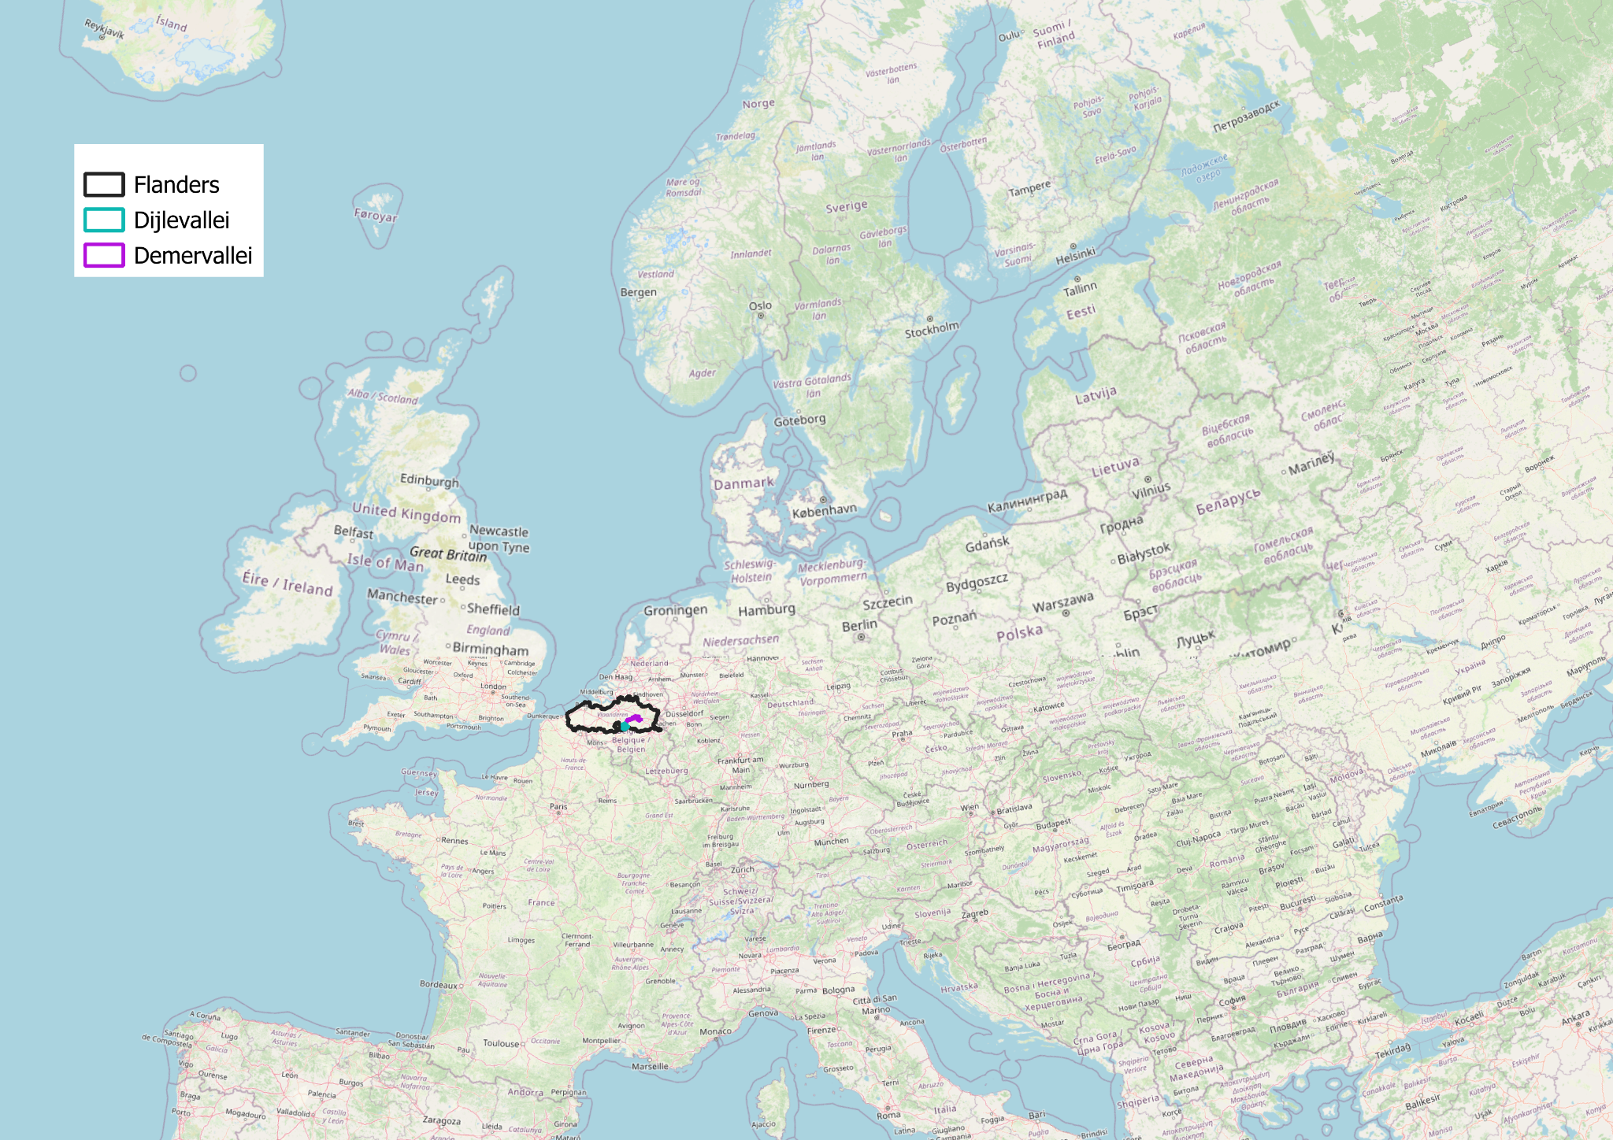
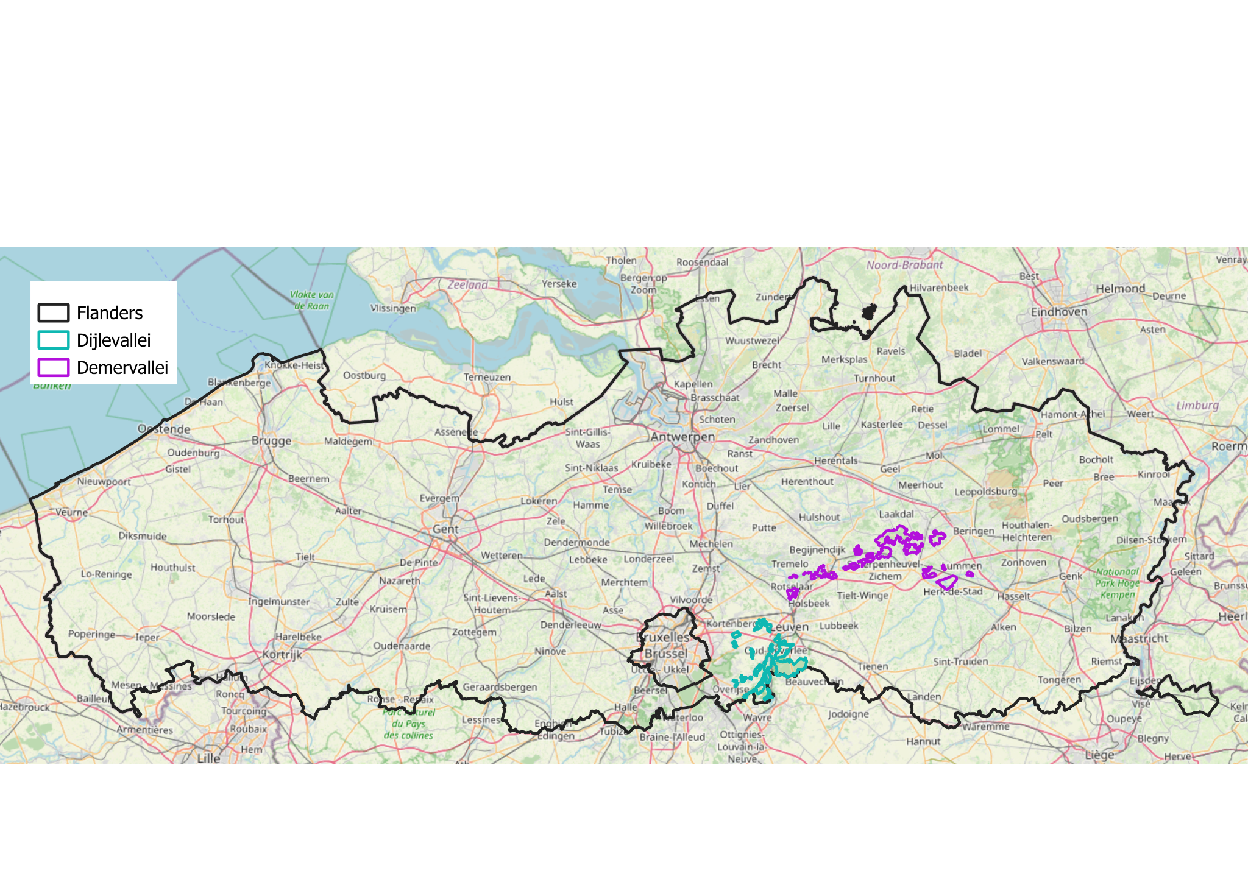
Study sites

Slide 3
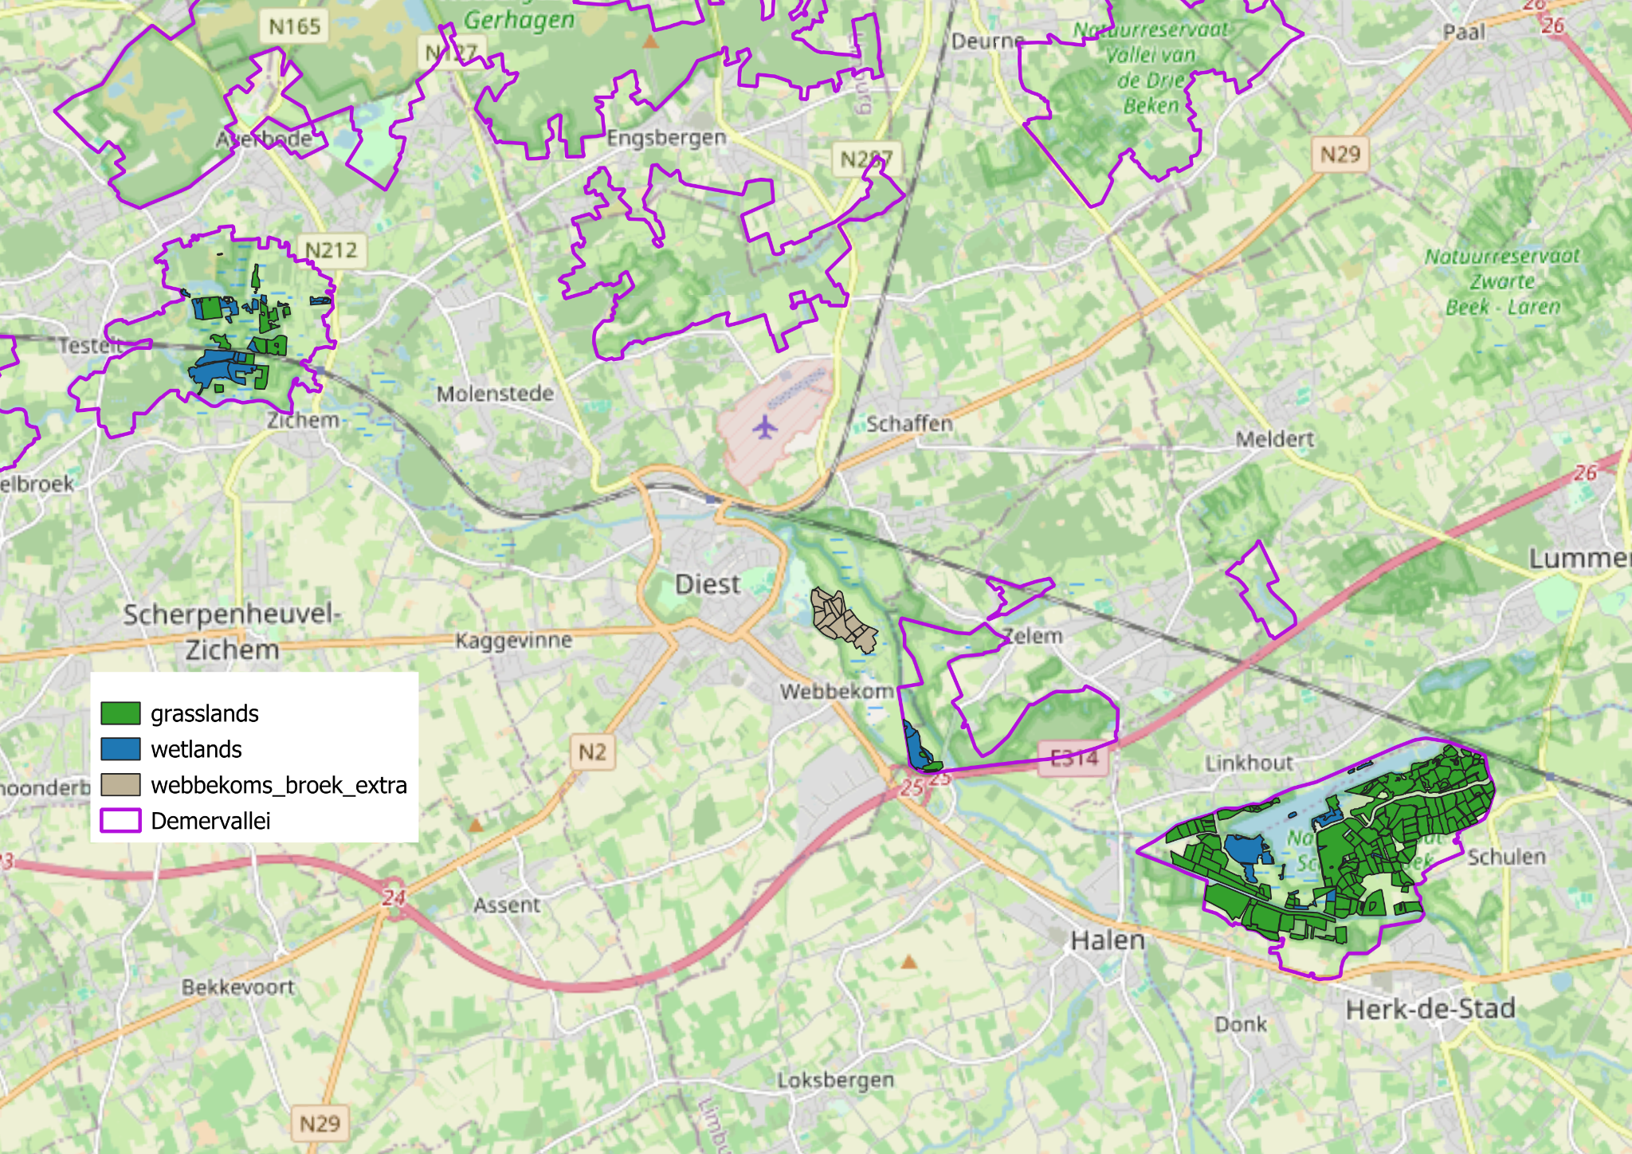
Study sites
Kloosterbeemden
Webbekoms Broek
Schulensbroek

Slide 4
Overview analysis workflow
Download a time series datacube of Sentinel-2 images for the study area (Hans’s script) in OpenEO.
→ already done for you (01/01/2020 – now)
Available bands: B02, B03, B04, B05, B08, B8A, B11, B12, SCL

Slide 5
Overview analysis workflow
Download a time series datacube of Sentinel-2 images for the study area (Hans’s script) in OpenEO.
Load the datasets:
a. the boundary of your study area (AOI)
b. the datacube
c. wms layers of ortho imagery + DTM (background layers)
d. Tytti’s model
e. reference points taken in the field

Slide 6
Overview analysis workflow
Download a time series datacube of Sentinel-2 images for the study area (Hans’s script) in OpenEO.
Load the datasets:
Data pre-processing:
a. removal of trees
b. explore historical ortho images of the area
c. preprocess the datacube
i. cloud and shadow masking
ii. regional masking
iii. calculate vegetation indices per pixel for the classification
iv. check radiometric offset

Slide 7
Question 1: which cloud cover threshold should we use? We now use a 5% threshold.

Slide 8
Question 1: which cloud cover threshold should we use? We now use a 5% threshold.
We often use a 10 or 20% cloud cover threshold.
 | 5% cloud cover threshold | 10% cloud cover threshold | 20% cloud cover threshold
Number of observations | 145 | 155 | 172
% of the total number of observations (853) | 17% | 18% | 20%
Notes:
Simuleer een resultaat

Slide 9
Overview analysis workflow
Download a time series datacube of Sentinel-2 images for the study area (Hans’s script) in OpenEO.
Load the datasets:
Data pre-processing:
Classification (Jussila + Wiw models)

Slide 10
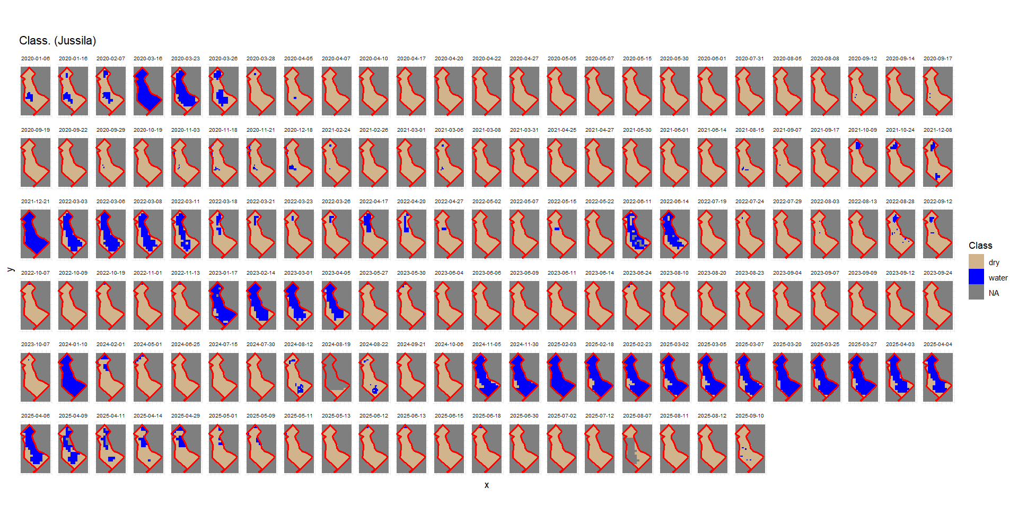

Slide 11
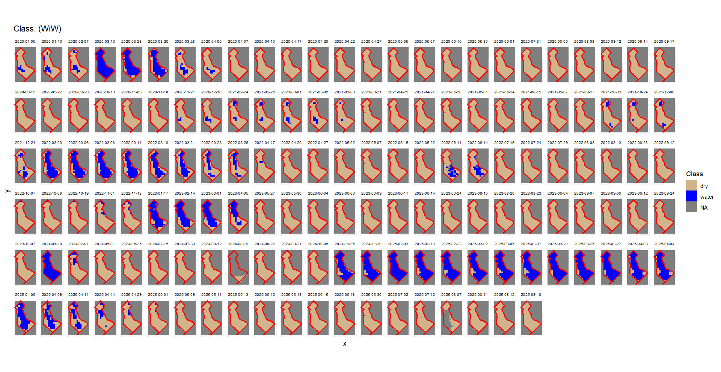

Slide 12
Question 2: can you already spot some differences between the two models?

Slide 13
Overview analysis workflow
Download a time series datacube of Sentinel-2 images for the study area (Hans’s script) in OpenEO.
Load the datasets:
Data pre-processing:
Classification (Jussila + Wiw models)
Visualize output of the last available date (Sentinel-2 image)
a. check the classification output
b. check the soil moisture/wetness indices
→ compare with the GPS data points form the terrain

Slide 14
Question 3: what can we conclude based form the last available Sentinel-2 image data? Does it match with our observations in the field?

Slide 15
Overview analysis workflow
Download a time series datacube of Sentinel-2 images for the study area (Hans’s script) in OpenEO.
Load the datasets:
Data pre-processing:
Classification (Jussila + Wiw models)
Visualize output of the last available date (Sentinel-2 image)
Time series indicator analysis

Slide 16
Overview analysis workflow
Download a time series datacube of Sentinel-2 images for the study area (Hans’s script) in OpenEO.
Load the datasets:
Data pre-processing:
Classification (Jussila + Wiw models)
Visualize output of the last available date (Sentinel-2 image)
Time series indicator analysis

Slide 17

Time series indicator analysis
Pixel level
AOI level
…
Spatial
Temporal
Spatial
Temporal
Decide spatial detail
GAP filling
Define indicator set
Decide temporal detail

Slide 18
Time series indicator analysis
Inundated vs non-inudated (classification result)
(We did this already for the last available date)
Band value (like B11) or moisture/wetness index (e.g. NDMI, STR)
Pixel level
AOI level
Spatial
Temporal
Spatial
Temporal
Decide spatial detail
GAP filling
Define indicator set
Decide temporal detail

Slide 19
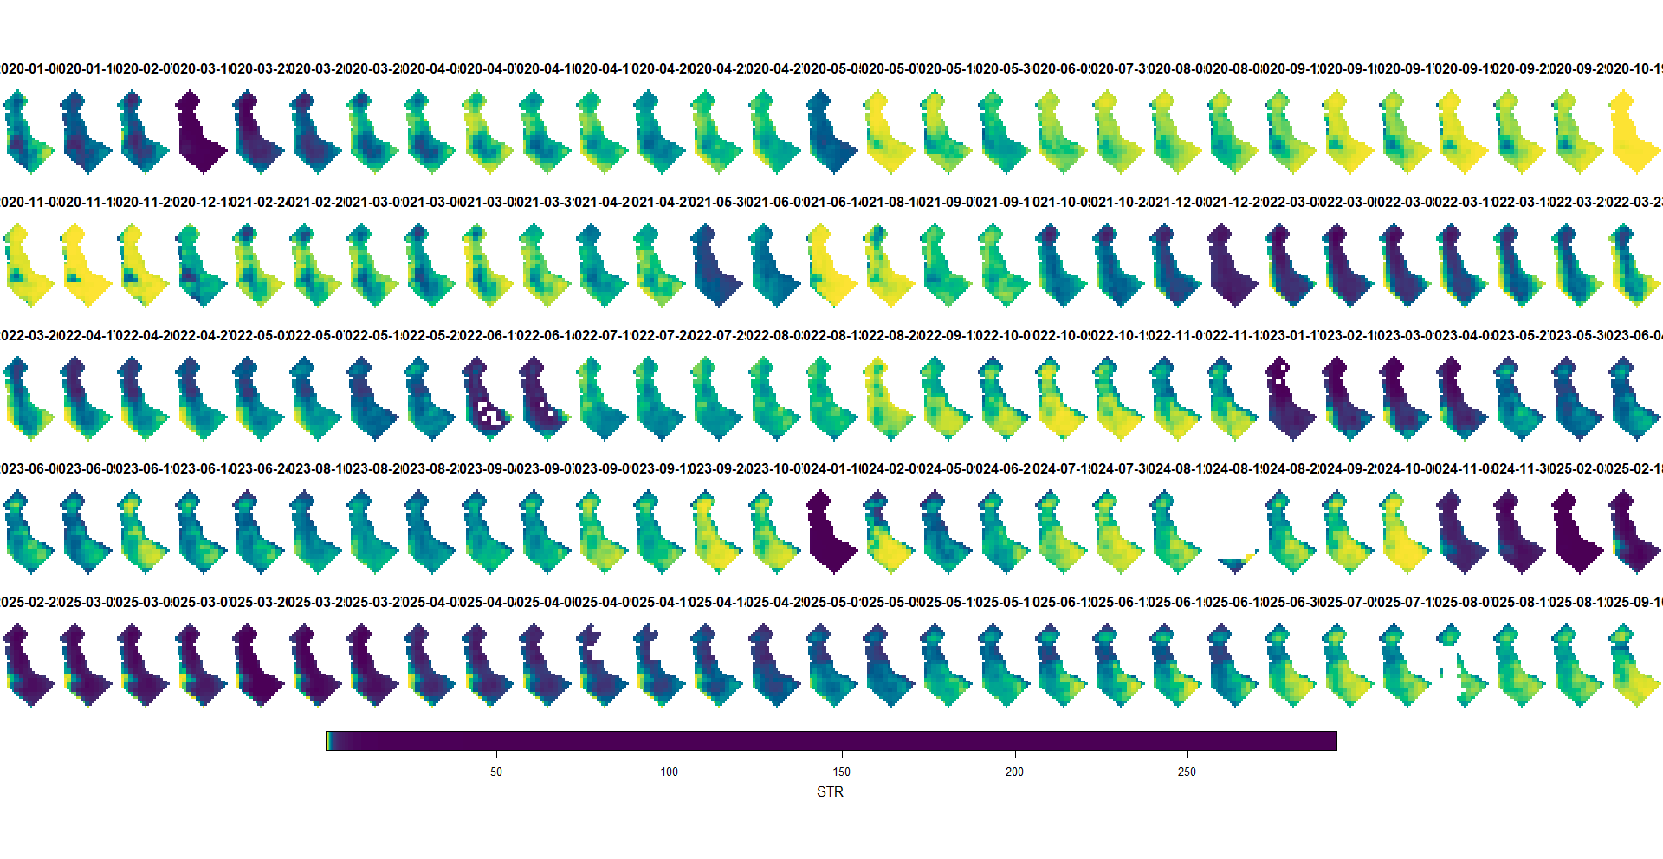
STR – shortwave-infrared transformed reflectance index.

Slide 20
Time series indicator analysis
Inundated vs non-inudated (classification result)
Band value (like B11) or moisture/wetness index (e.g. NDMI)
Pixel level
AOI level
Spatial
Temporal
Spatial
Temporal
Decide spatial detail
GAP filling
Define indicator set
Decide temporal detail
% of inundation (classification result)
Spatial statistics on band value (like B11) or moisture/wetness index (e.g. NDMI)
* Central estimate: mean, median,…
* Variance estimate: CV, std, variance, range, IQR,…
* (Extreme estimate: min., max.)

Slide 21
Question 4: in which case would we want to monitor on pixel level / on plot level?

Slide 22
Question 4: in which case would we want to monitor on pixel level / on plot level?
Pixel level: when we want to keep spatial information, e.g. when your plot/area delineates a heterogenous habitat.
Plot level: when spatial information within your area is not required.

Slide 23
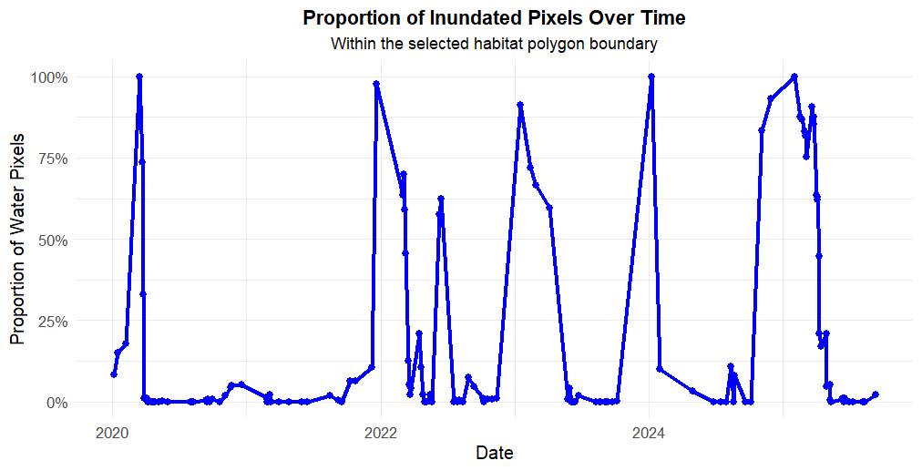
Evaluation on plot level: % inundated (Jussila model)

Slide 24
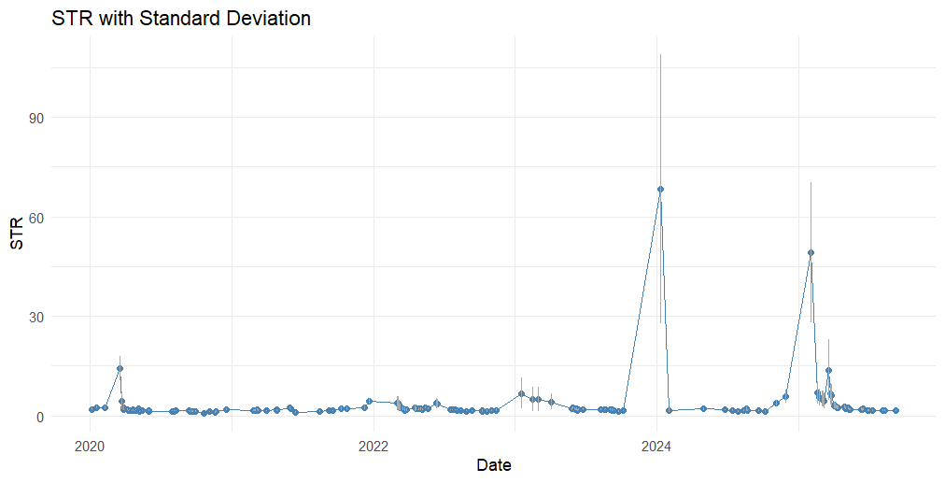
Evaluation on plot level: mean STR + sd (error bars)

Slide 25
Time series indicator analysis
Pixel level
AOI level
Spatial
Temporal
Spatial
Temporal
Decide spatial detail
GAP filling
Define indicator set
Decide temporal detail

Slide 26

Warning
Next few slides can become technical.
If you feel confused or dizzy. Don't panic, the presenter is also confused.
We will try summary the main conclusions and give concrete examples.

Slide 27

Problems with our datacube

Slide 28
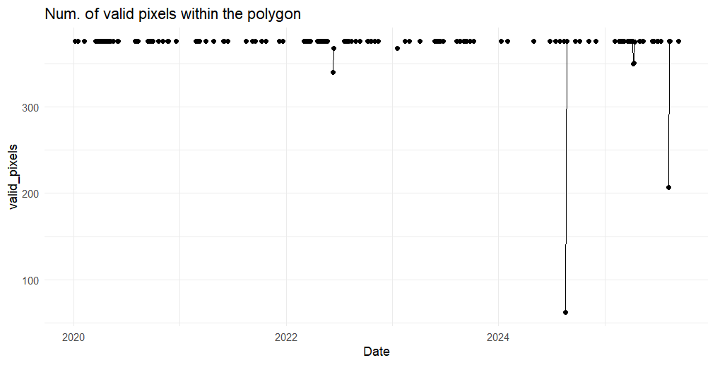
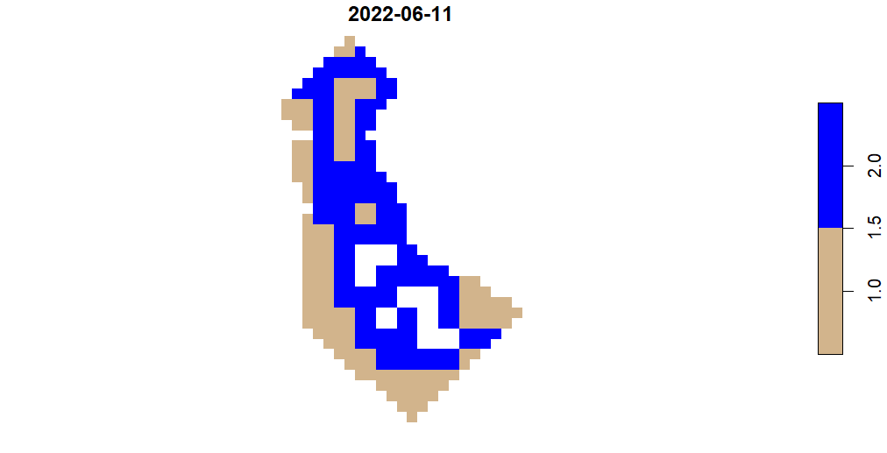
Spatial gaps
Missing values due to cloud masking

Slide 29
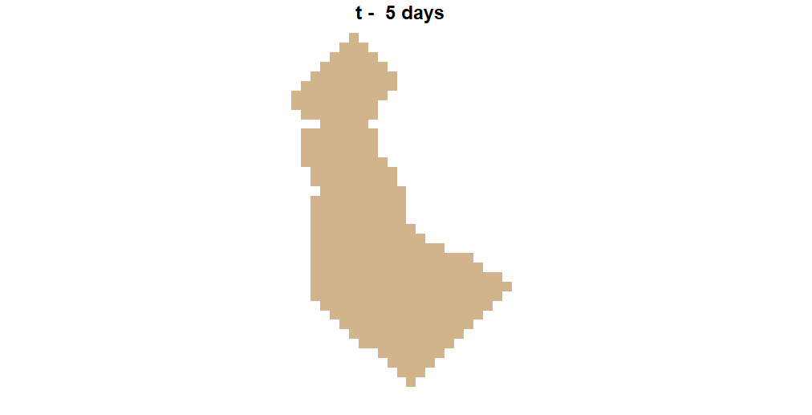
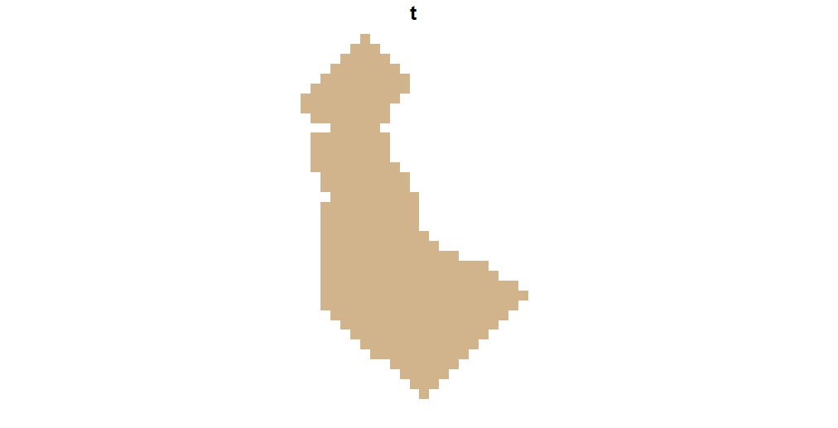
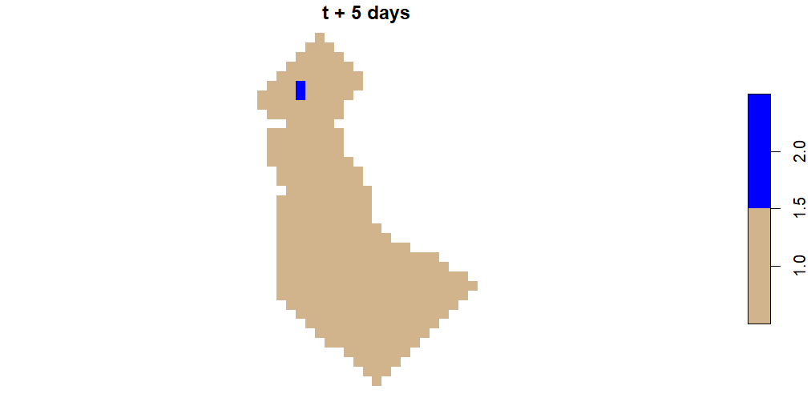
Temporal gaps
Revisit time of Sentinel-2 → 5 days (2/3 days for most places in Flanders)
?

Slide 30
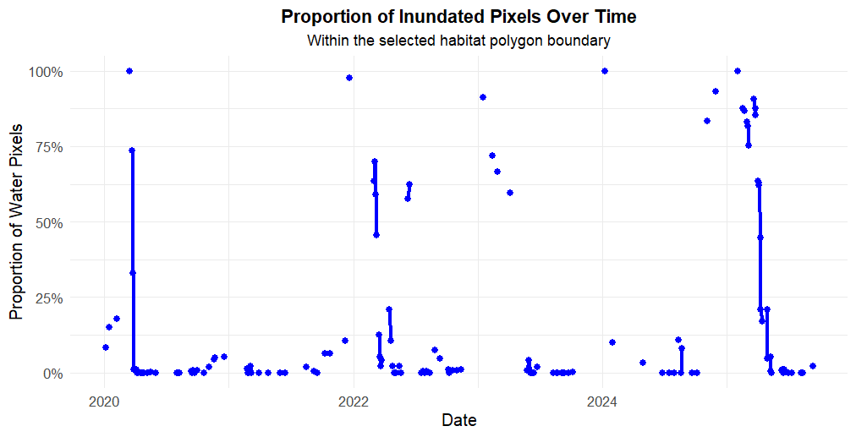
Evaluation on plot level: % inundated (Jussila model)
Time gap > 5 days (revisit time Sentinel-2).

Slide 31
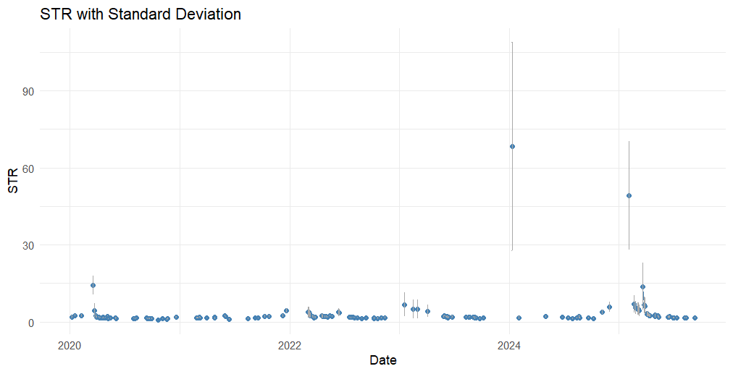
Evaluation on plot level: mean STR + sd (error bars)
Time gap > 5 days (revisit time Sentinel-2).

Slide 32


Problem: How to deal with missing values (spatially, temporarely)?
Lower the cloud cover threshold filter and rely on cloud masking (suboptimal)
Data fusion/prediction:
E.g. Landsat - Sentinel-2 harmonized time series: https://hls.gsfc.nasa.gov/
E.g. use Sentinel-1 data to predict values for Sentinel-2: https://blog.vito.be/remotesensing/cropsar2023
Interpolation:
Spatial versus temporal interpolation
Which interpolation function should we use?
On which spatial (pixel vs plot) and temporal level (e.g. 5 days vs 14 days)

Slide 33
Spatial interpolation
Which value do you think this pixel would have?
?

Slide 34
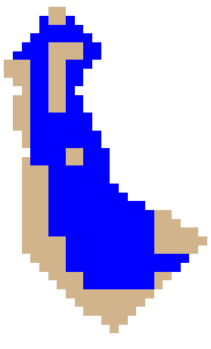
Spatial interpolation
Which value do you think this pixel would have?
E.g. spatial interpolation based on majority voting with 3x3 kernel
Many spatial interpolation techniques exists, like IDW, NN, ordinary Kriging,…

Slide 35
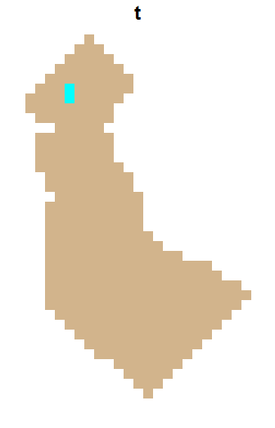
Temporal interpolation
?

Slide 36
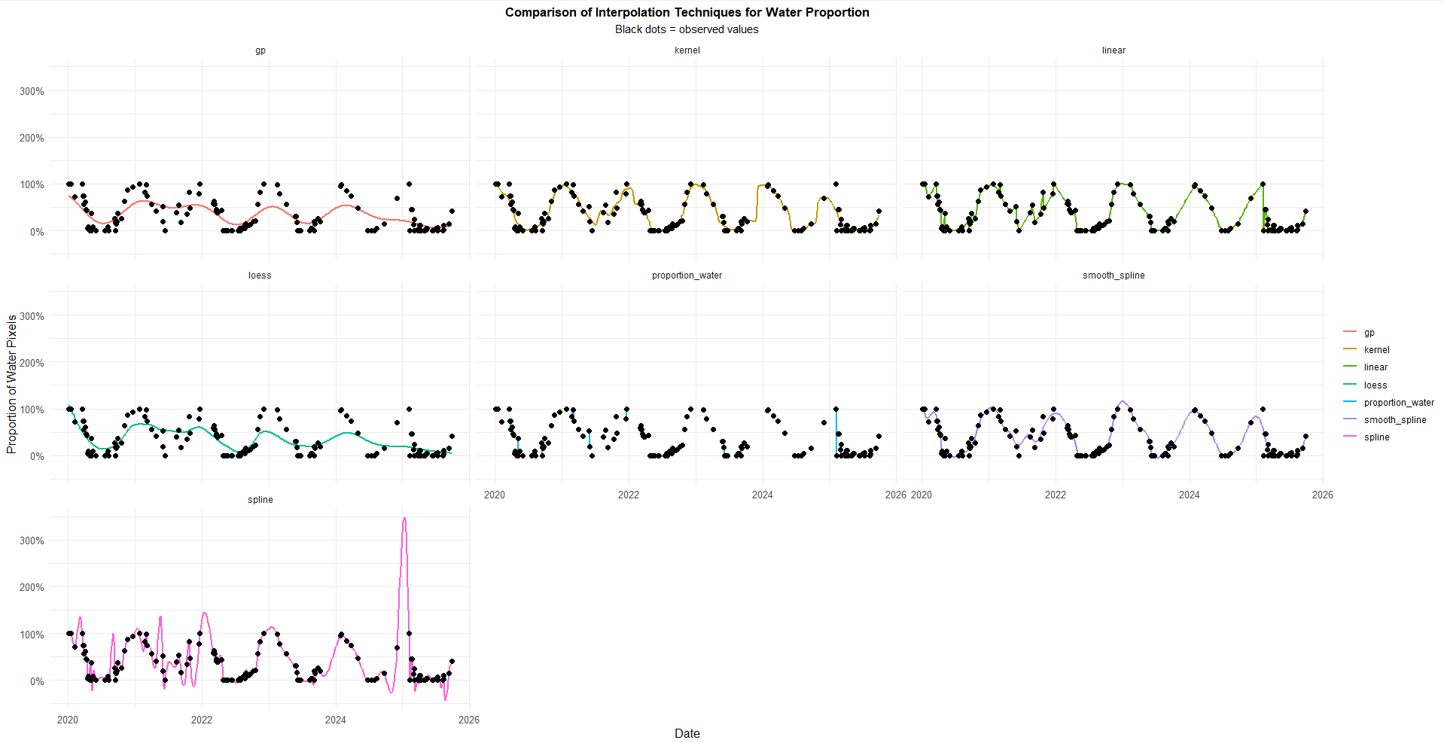

Slide 37
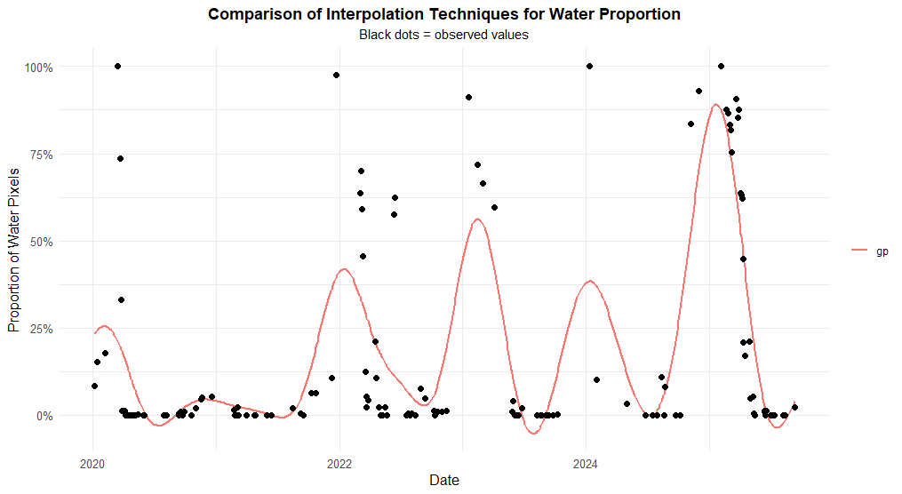

Slide 38
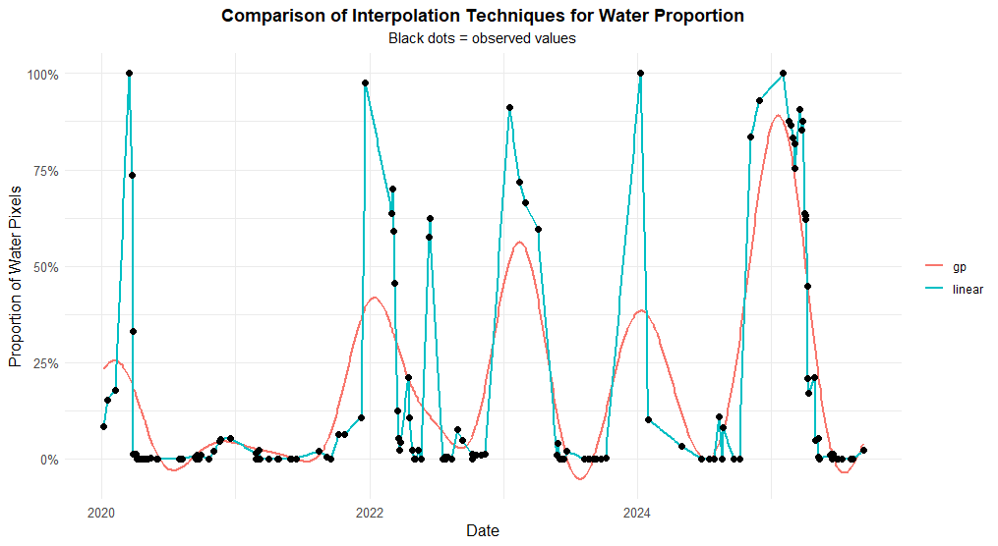

Slide 39
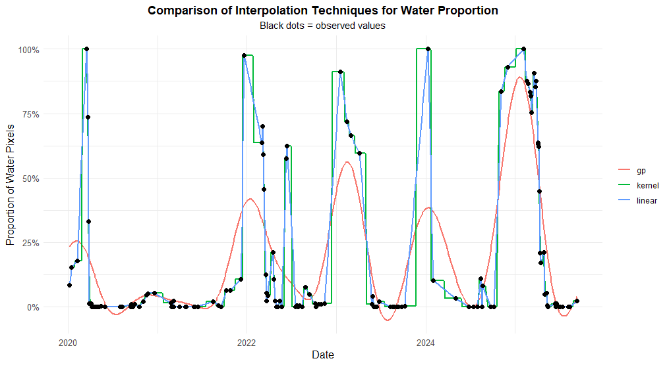

Slide 40
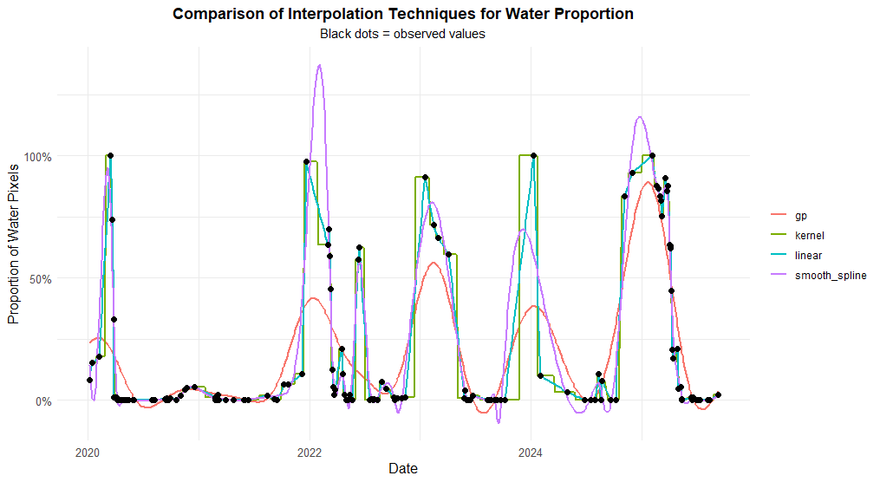

Slide 41
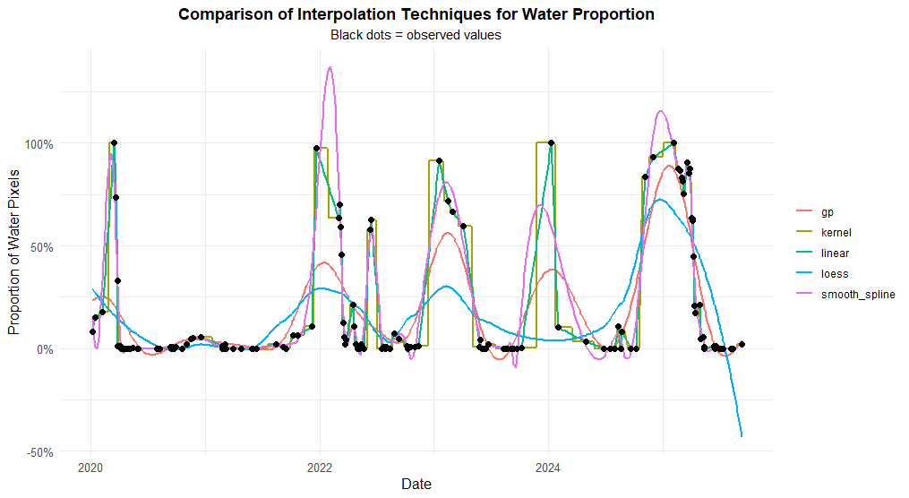

Slide 42
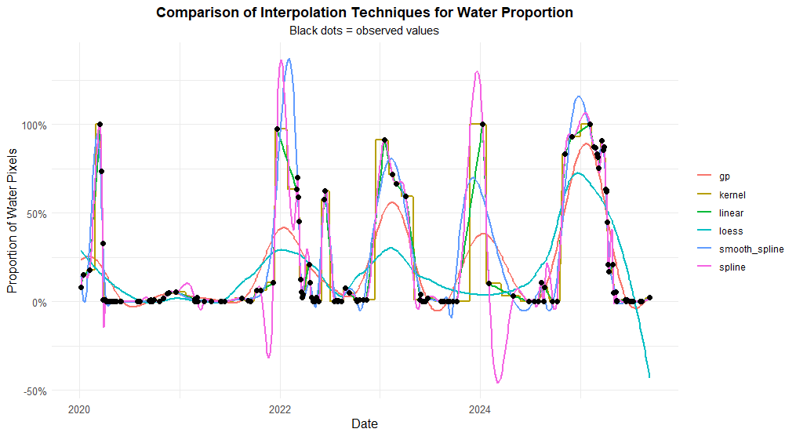

Slide 43
Example of 6 different interpolation techniques for the % of inundation
(no temporal aggregation).
In my opinion:
Overfit:
Spline interpolation
Linear interpolation (prone to atmospheric conditions and errors of the models)
Kernel regression (but can give “steps” in the interpolation)
Underfit:
Loess regression
linear interpolation
Both over- and underfit:
Smoothing spline interpolation
→ We still need to finetune the parameters in these interpolation techniques or use additional smoothing in case of overfitting. For seasonal events, you can use harmonic interpolation (but you can miss “rare” events).
More advanced interpolation technique (combines temporal interpolation, temporal smoothing and temporal aggregation):
https://pubmed.ncbi.nlm.nih.gov/39650555/

Slide 44
Problem: How to deal with missing values (spatially, temporarely)?
Lower the cloud cover threshold filter and rely on cloud masking (suboptimal)
Data fusion/prediction:
E.g. Landsat - Sentinel-2 harmonized time series: https://hls.gsfc.nasa.gov/
E.g. use Sentinel-1 data to predict values for Sentinel-2: https://blog.vito.be/remotesensing/cropsar2023
Interpolation:
Which interpolation function should we use?
On which spatial (pixel vs plot) and temporal level (e.g. 5 days vs 14 days)
Temporal aggregation:

Slide 45
Option 4: temporal aggregation
Choose a aggregation function:
Pixel level:
For classification output (0,1)
Central estimates: Mode (Median here since mode does not work if freq. = 1 🡪 if case of equal frequencies = 0,5 (should be given a new class))
Variance estimates: p * (1 – p) (with p the relative frequency of inundation)
Extreme estimates: min, max
Moisture/wetness indices
Central estimates: mean, median,…
Variance estimates: variance, std, CV, range, IQR,…
Extreme estimates: min, max
Plot level (% of inundation or moisture/wetness indices):
Central estimates: mean, median,…
Variance estimates: variance, std, CV, range, IQR,…
Extreme estimates: min, max
Choose a time interval:
10 days, 14 days (bi-weekly), 1 month, 3 months (season), 1 year,…

Slide 46
Option 4: temporal aggregation
Choose a aggregation function:
Pixel level:
For classification output (0,1)
Central estimates: Mode (Median here since mode does not work if freq. = 1 🡪 if case of equal frequencies = 0,5 (should be given a new class))
Variance estimates: p * (1 – p) (with p the relative frequency of inundation)
Extreme estimates: min, max
Moisture/wetness indices
Central estimates: mean, median,…
Variance estimates: variance, std, CV, range, IQR,…
Extreme estimates: min, max
Plot level (% of inundation or moisture/wetness indices):
Central estimates: mean, median,…
Variance estimates: variance, std, CV, range, IQR,…
Extreme estimates: min, max
Choose a time interval:
10 days, 14 days (bi-weekly), 1 month, 3 months (season), 1 year,…

Slide 47
Question 5: What are the advantages and disadvantages of using the min/max aggregation function on Tytti’s model (0: dry, 1: inundated). When would you use it?

Slide 48
Question 5: What are the advantages and disadvantages of using the min/max aggregation function on Tytti’s model (0: dry, 1: inundated). When would you use it?
Advantages: detection of “rare” events (and keep the spatial information)
- e.g. in very dry areas where you want to detect inundation ,
or you want to detect complete drying of your area.
→ max. aggregation.
- e.g. in very wet areas where you want to detect desiccation,
or you want to detect complete flooding of your area.
→ min. aggregation
Disadvantage: sensitive to outliers (caused by problems in signal (atmosphere) or the model).
If you want more “smoothing” (general patterns) → use the mode (categorical) or median (on the numeric values of the categories (we handle categorical values as conitinous ones)).

Slide 49
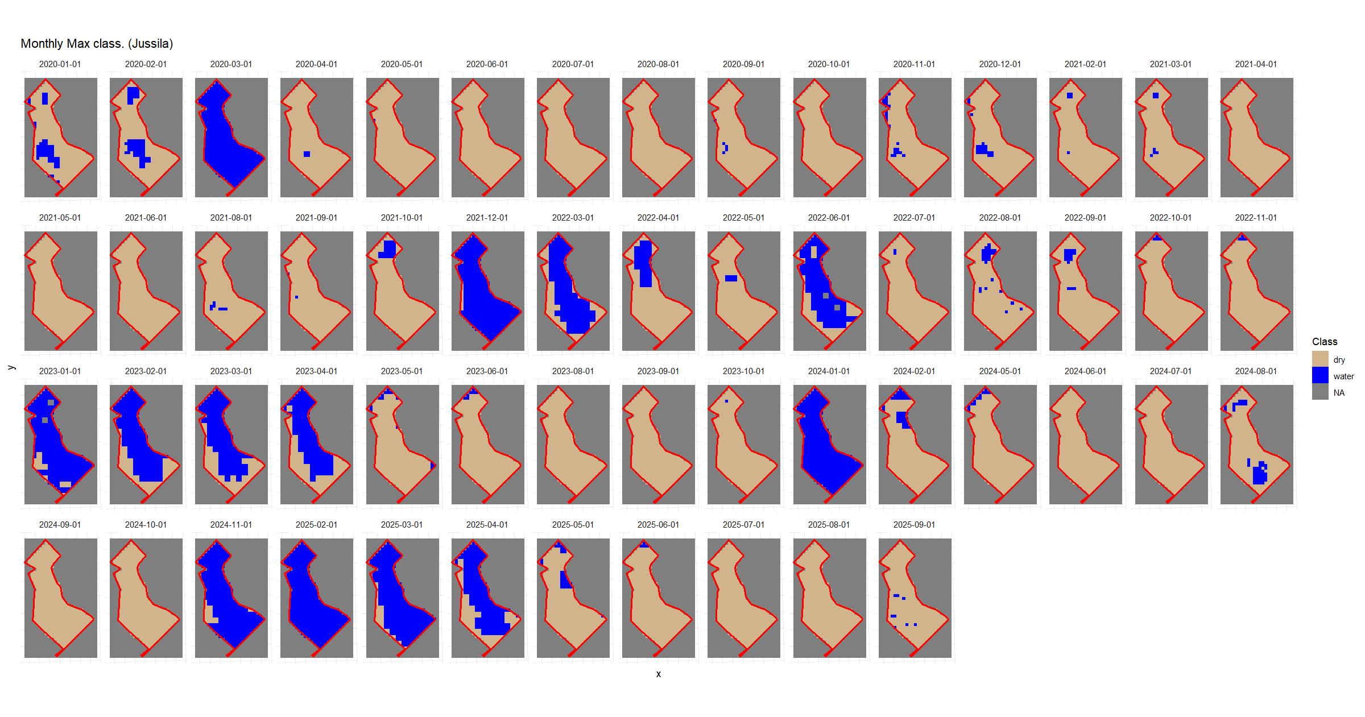
Example: pixel level, classification, max. aggregation
1. Monthly aggregation

Slide 50
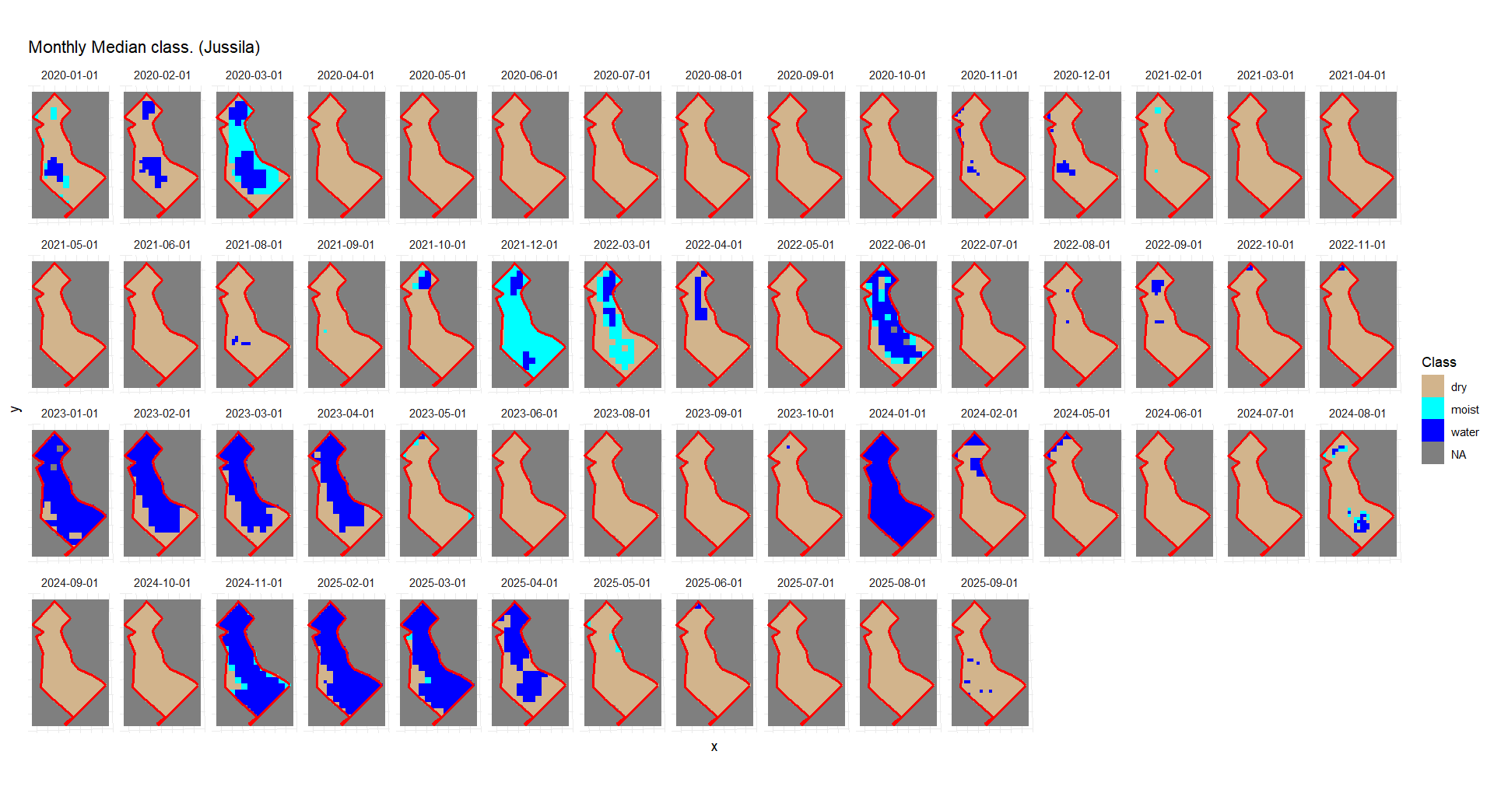
Example: pixel level, classification, median aggregation
1. Monthly aggregation

Slide 51
If we would spatially aggregate (% inundated) for each month, what would be the difference?

Slide 52
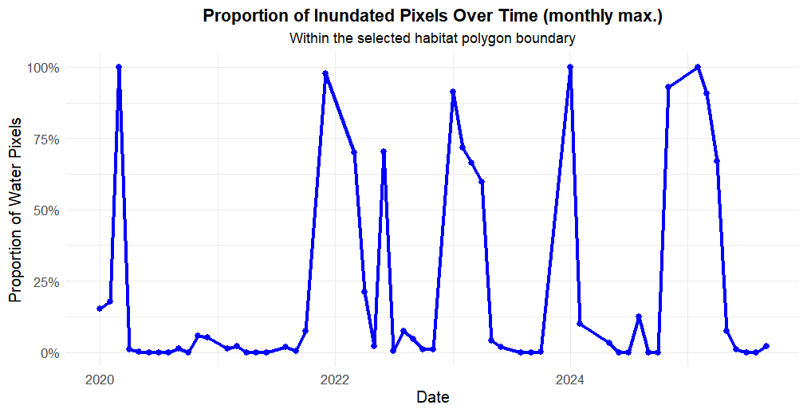

Slide 53
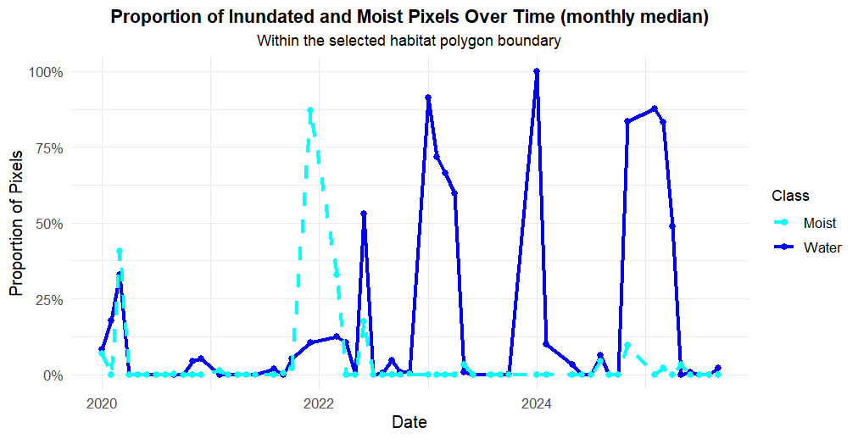
If we would spatially aggregate (% inundated) for each month, what would be the difference?
When still considering 0,5 and 1 as “discrete” pixels

Slide 54
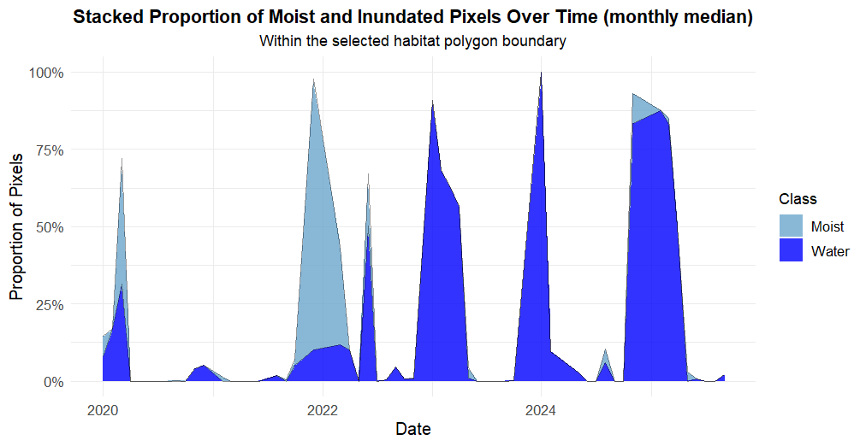
When still considering 0,5 and 1 as “discrete” pixels

Slide 55
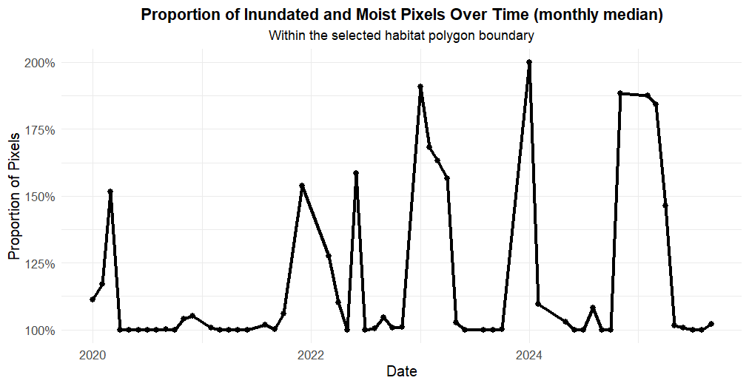
When still considering 0,5 and 1 as “continious” pixels

Slide 56
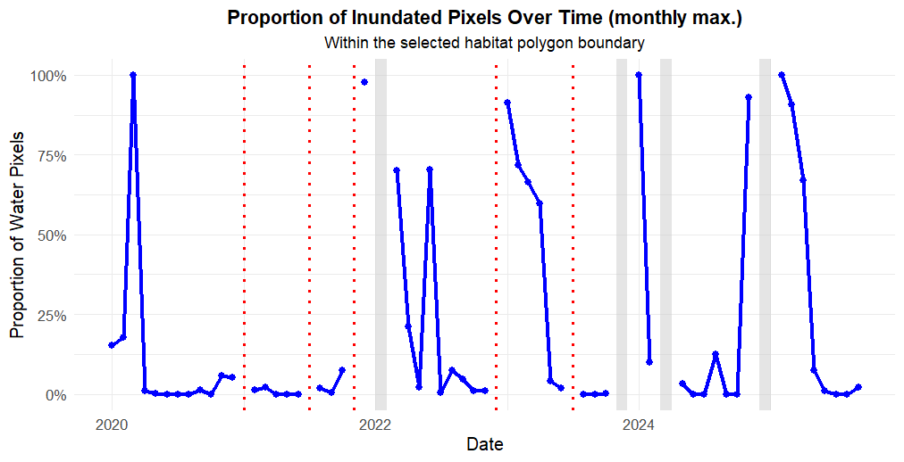
But even after monthly aggregation of the pixel values, we still have spatial and temporal gaps…

Slide 57
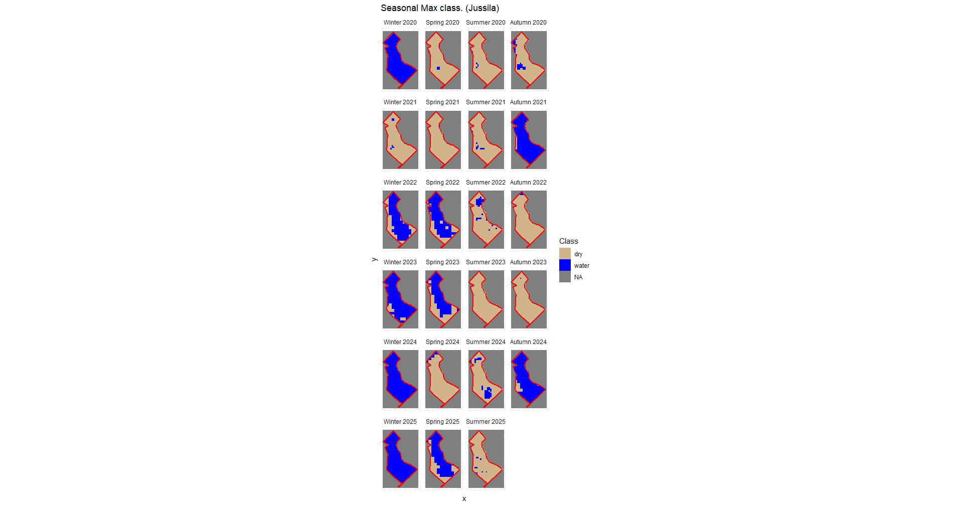
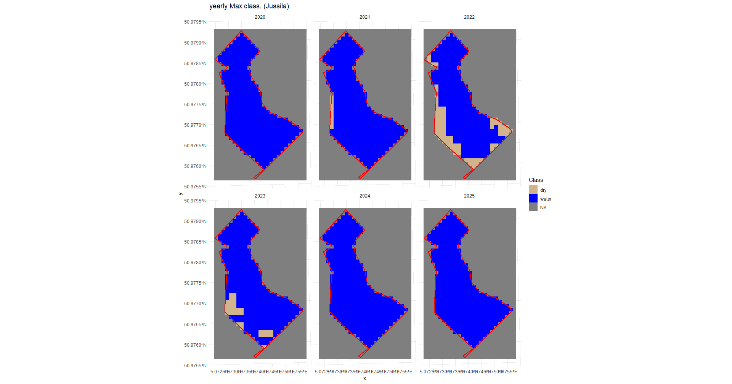
Larger timeblocks for aggregation is possible to create “regular” time series, but you loose information/relevancy…

Slide 58
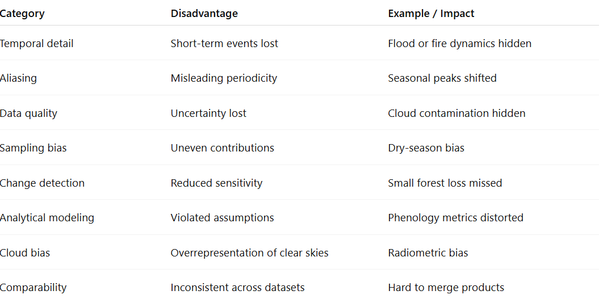
General problems/challenges with temporal aggregation

Slide 59
Problem: How to deal with missing values (spatially, temporarely)?
Lower the cloud cover threshold filter and rely on cloud masking (suboptimal)
Data fusion/prediction:
E.g. Landsat - Sentinel-2 harmonized time series: https://hls.gsfc.nasa.gov/
E.g. use Sentinel-1 data to predict values for Sentinel-2: https://blog.vito.be/remotesensing/cropsar2023
Often, a combination of the gap filling methods results in the best solution
Interpolation:
Spatial versus temporal interpolation
Which interpolation function should we use?
On which spatial (pixel vs plot) and temporal level (e.g. 5 days vs 14 days)
Temporal aggregation:

Slide 60

But… in which order should I lay the puzzle?
Again, depends on your case your interested.
Most common practice for general time series analysis:
1. Cloud mask
2. (optional small-gap spatial interpolation)
3. Temporal aggregation
4. Temporal interpolation/smoothing
Temporal aggregation
However…
For general phenology / seasonal curve-fitting applications.
Spatial inter-polation
Tempoal interpolation
Smoothing

Slide 61
Time series indicator analysis
Pixel level
AOI level
Spatial
Temporal
Spatial
Temporal
Decide spatial detail
GAP filling
Define indicator set
Decide temporal detail
When is there inundation?
Which area is inundated?
How much is the area inundated?
How long?
Changes in trend, seasonality,…

Slide 62
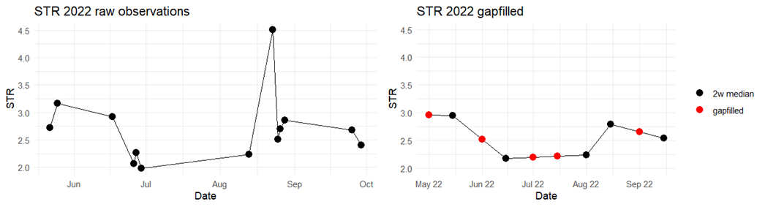
E.g. Monitoring aapa mires by Titty
Pixel level
Temporal aggregation, median
(2 weekly)
Temporal interpolation (linear)
Spatial: pixel and plot level
Temporal: year
Decide spatial detail
GAP filling
GAP filling
Define indicator set
Temporal aggregation on (year level) on pixel level:
3 functions: min, max, mean
2. Spatial aggregation (plot level).
Plot scale:
Spatial average + range, visualized in a trend plot for soil/wentess indicators
Minimum and maximum range of inundated area 🡪 % wet, % dry, % seasonally
% of permanent dry, % seasonal and % permanetn wet pixels.

Slide 63
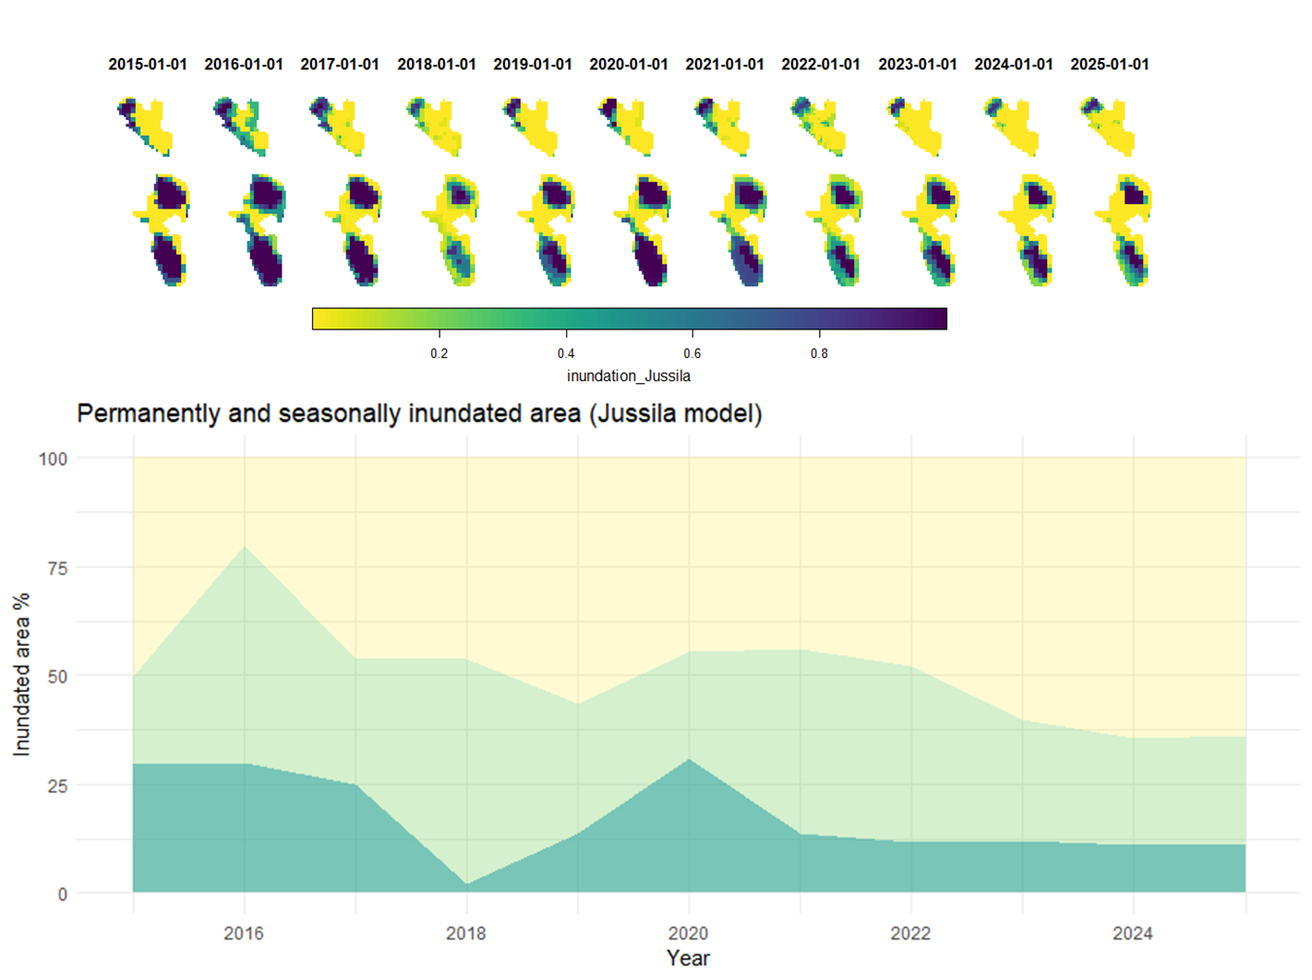
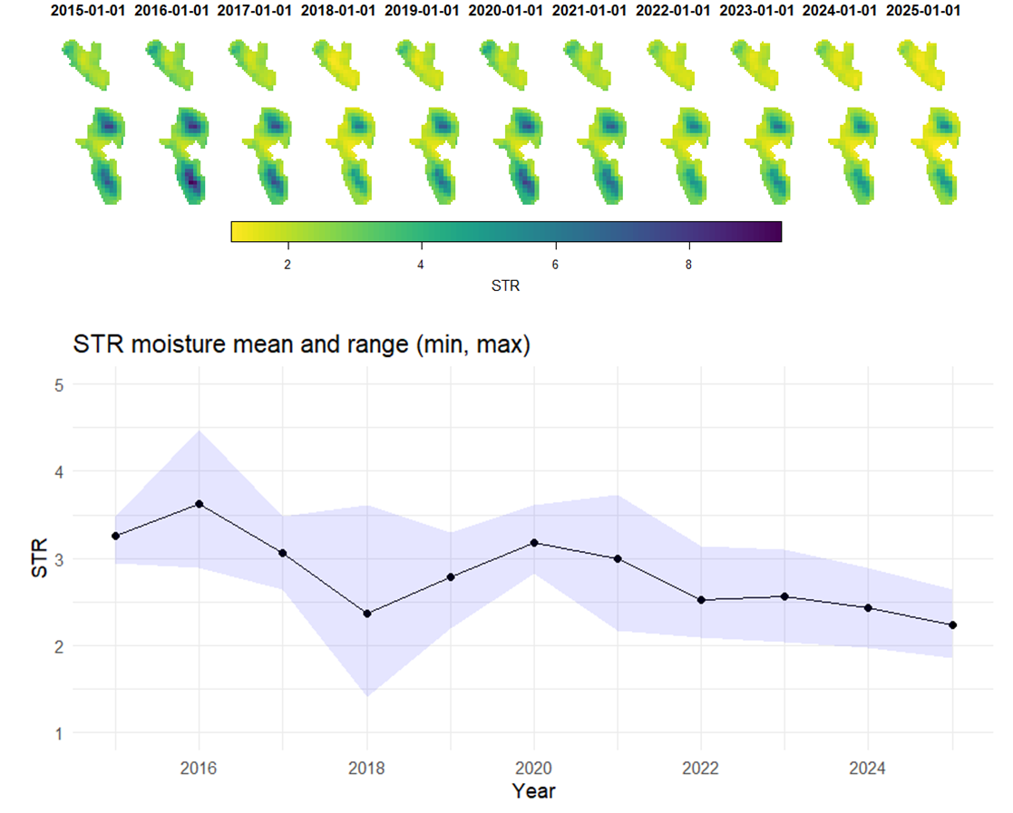
Tytti’s indicators

Slide 64
Tytti’s indicators

Slide 65
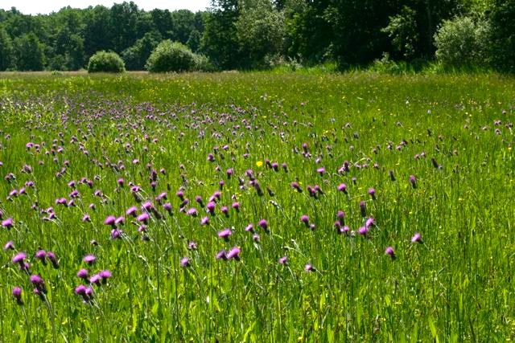
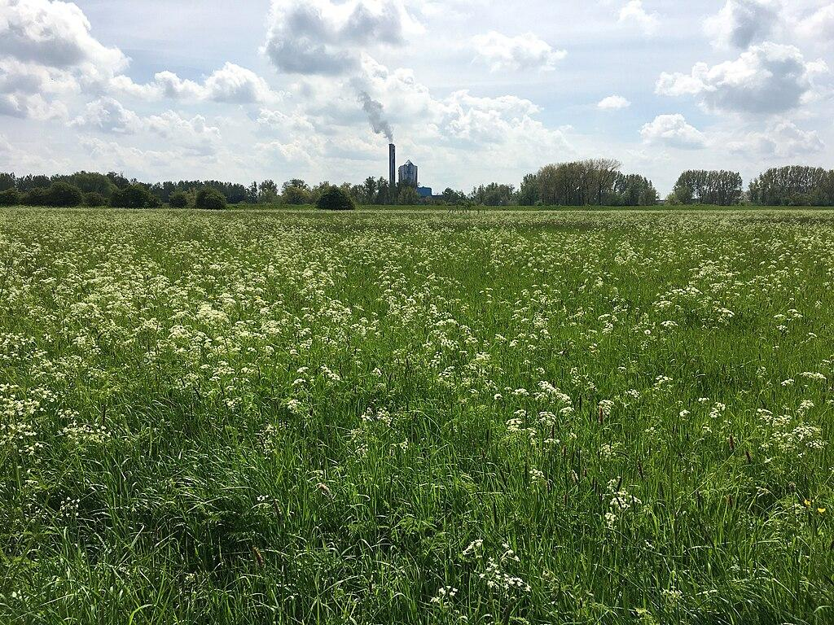
Tytti’s indicators
In our area we have:
Permanent water bodies
Seasonally inundated grasslands
When the grassland are inundate too frequently or too long
→ grassland degradation (loss in biodiversity)

Slide 66
Adaptations to Tytti’s pipeline:
Pixel level
Spatial aggregation, 3x3 kernel with majority voting
Temporal aggregation, median (per month)
Temporal interpolation (linear)
Average inundation per pixel over a year.
% permanent wet, dry and seasonally inundated
Decide spatial detail
GAP filling
GAP filling
GAP filling
Define indicator set
+ uncertainty visualization:
Spatial completeness per month: number of valid pixels
Temporal completeness: % of valid months

Slide 67
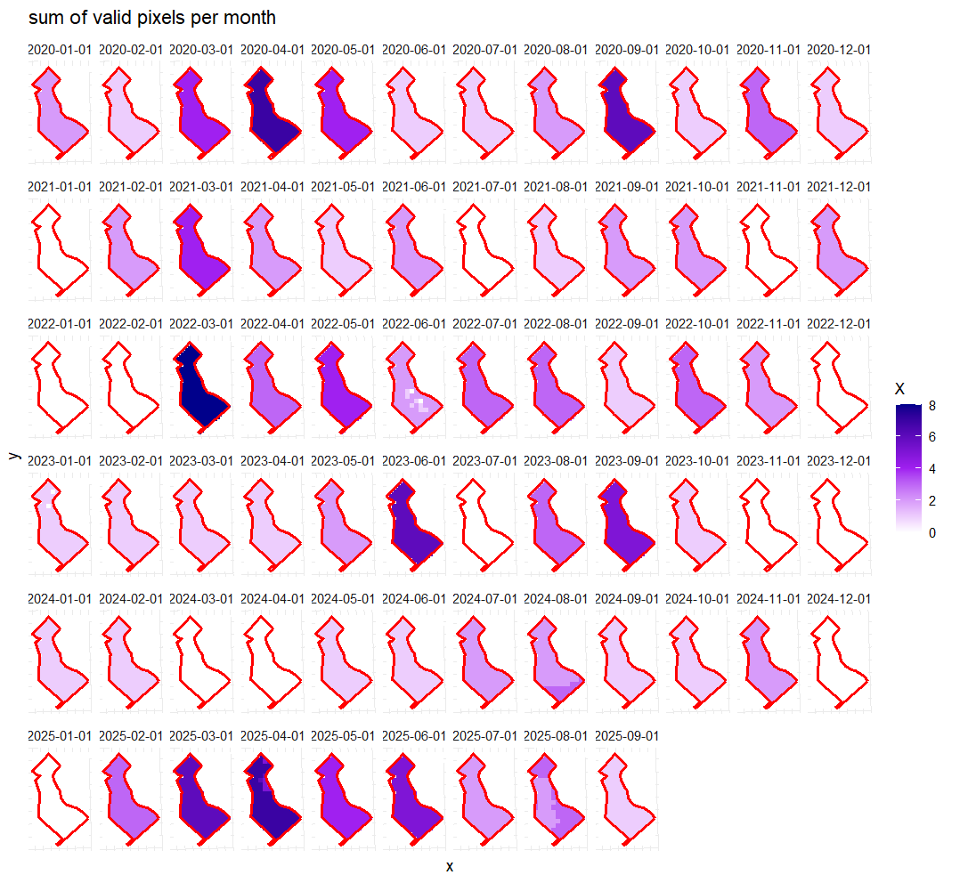
Adaptations to Tytti’s pipeline:
+ uncertainty visualization:
Spatial completeness per month: number of valid pixels
Temporal completeness: % of valid months
In white: the missing months
Legend: sum of valid pixels
→ expected sum is between 5 and 6 (5 day revisit time), 9-10 (3 day revisit time)
→ Clear under representation of winter months.

Slide 68
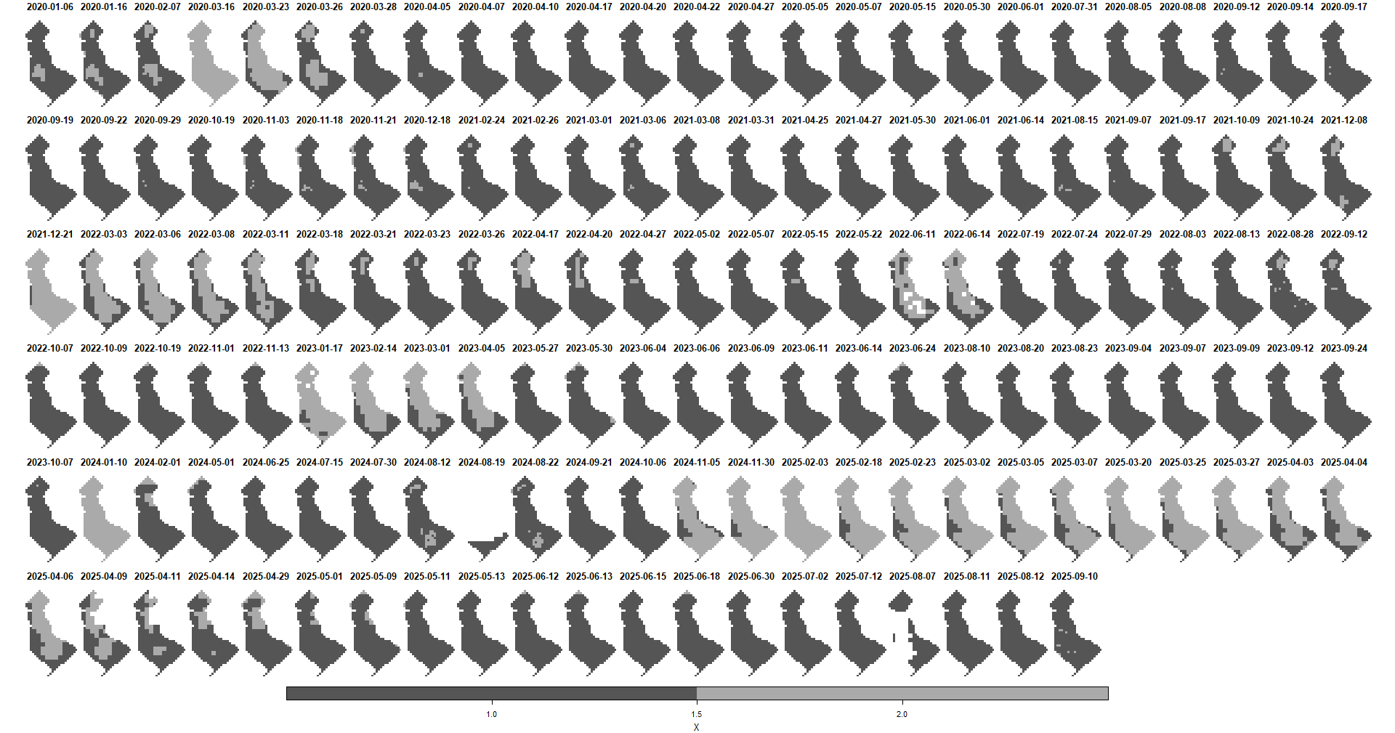
Spatial gap filling

Slide 69
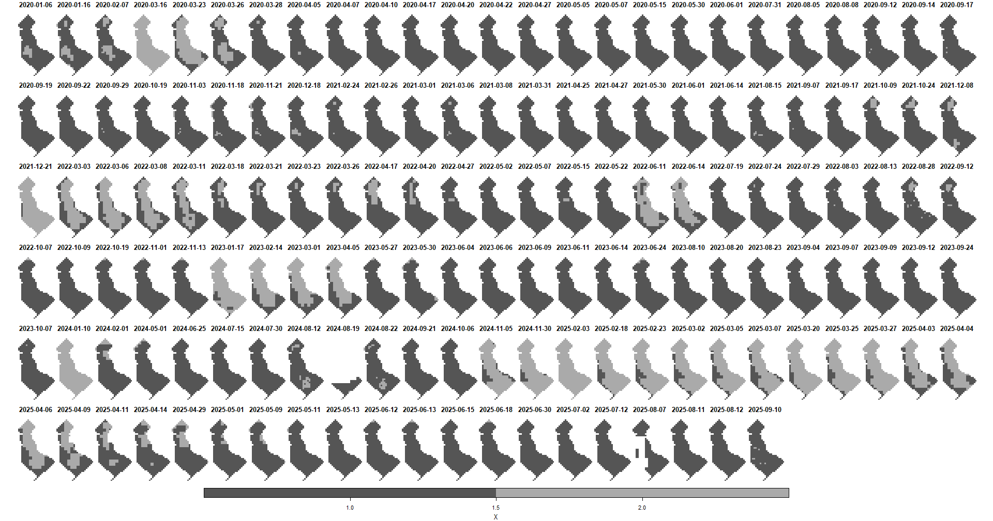
Spatial gap filling

Slide 70
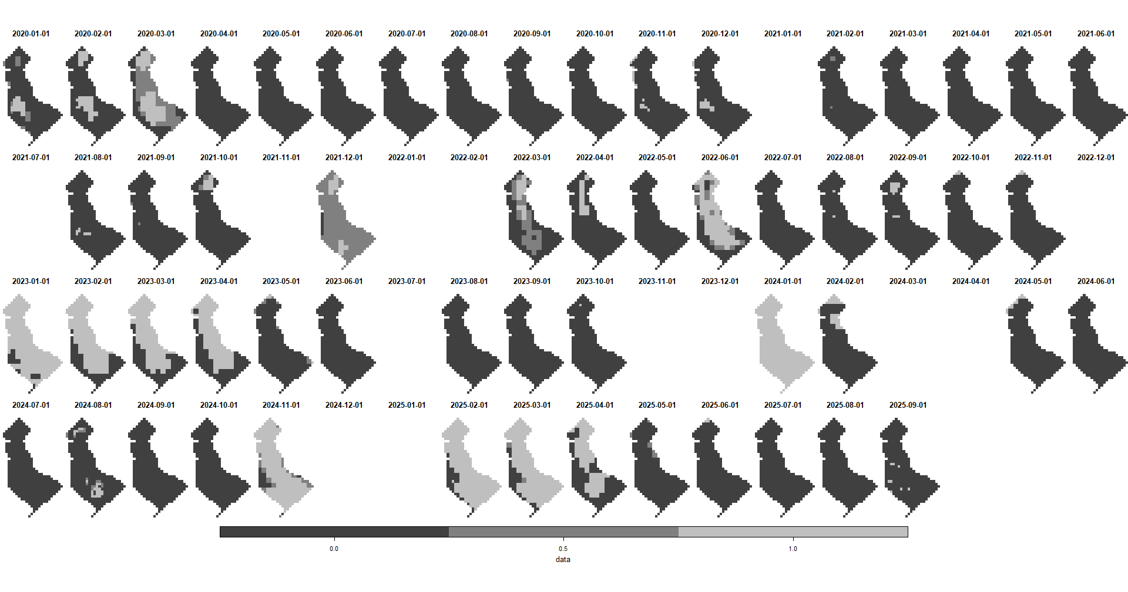
Temporal aggregation (median value per month)

Slide 71
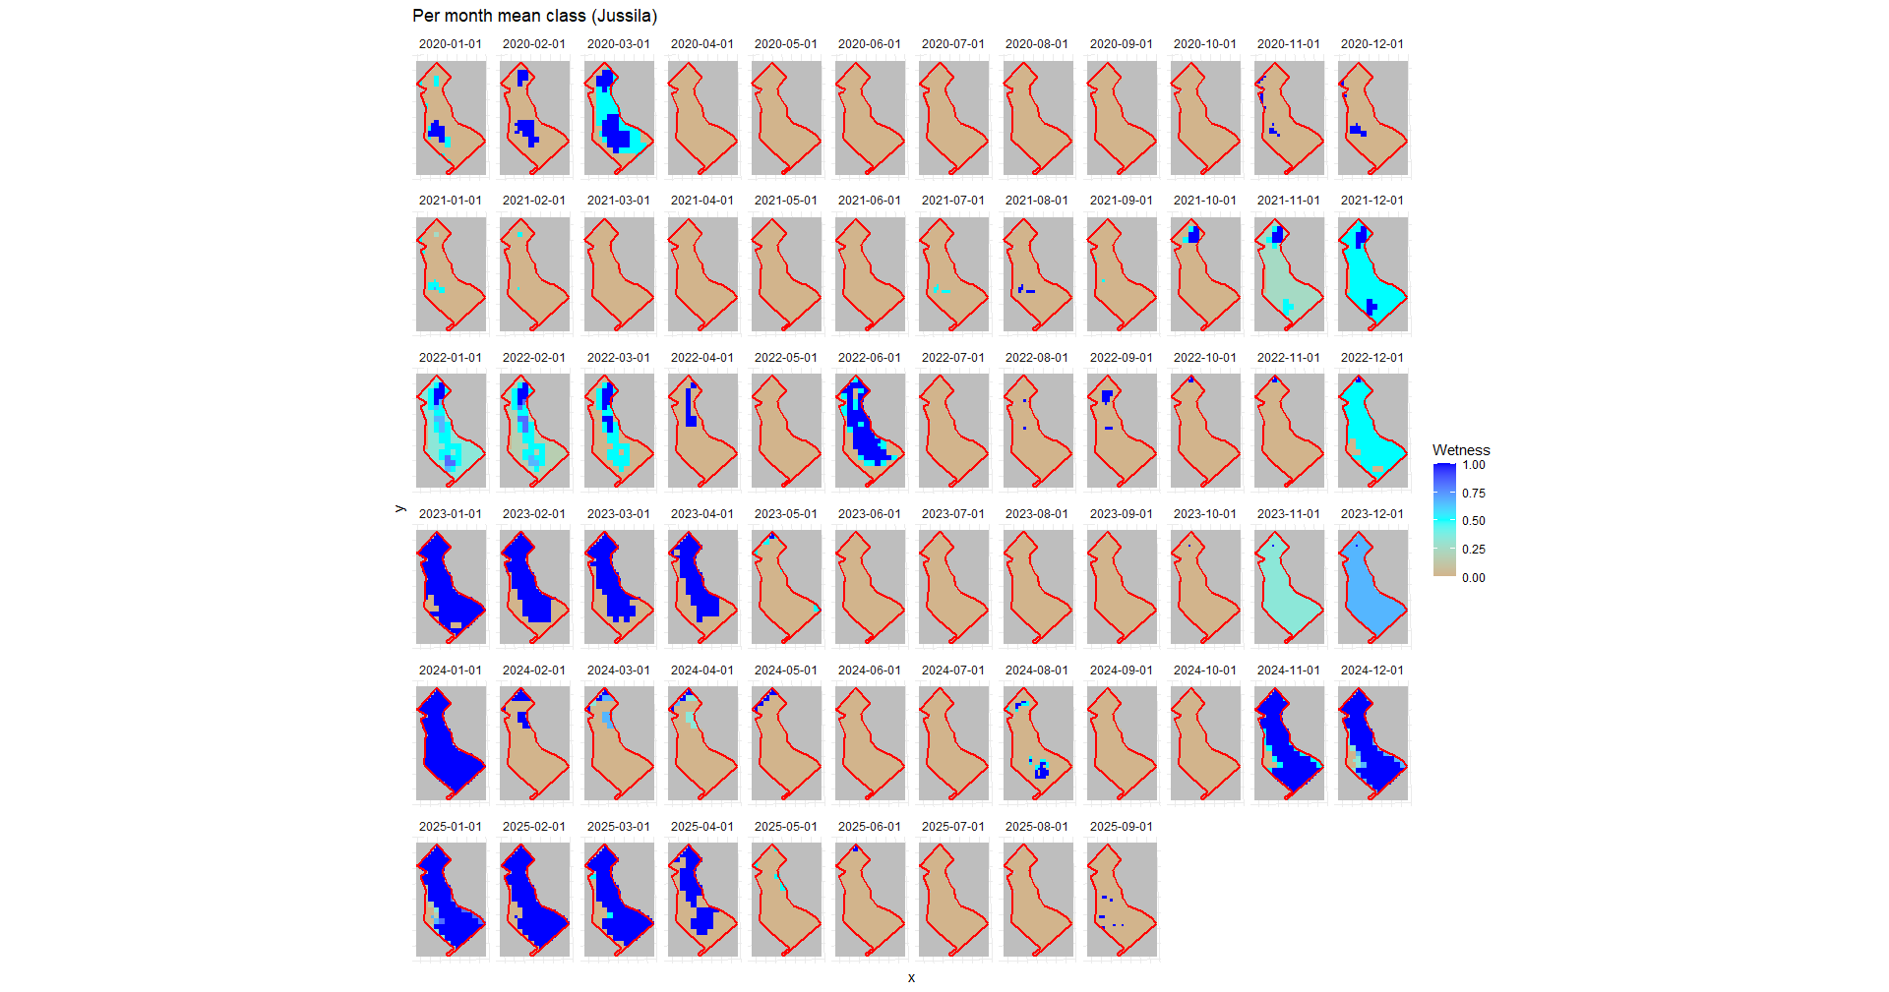
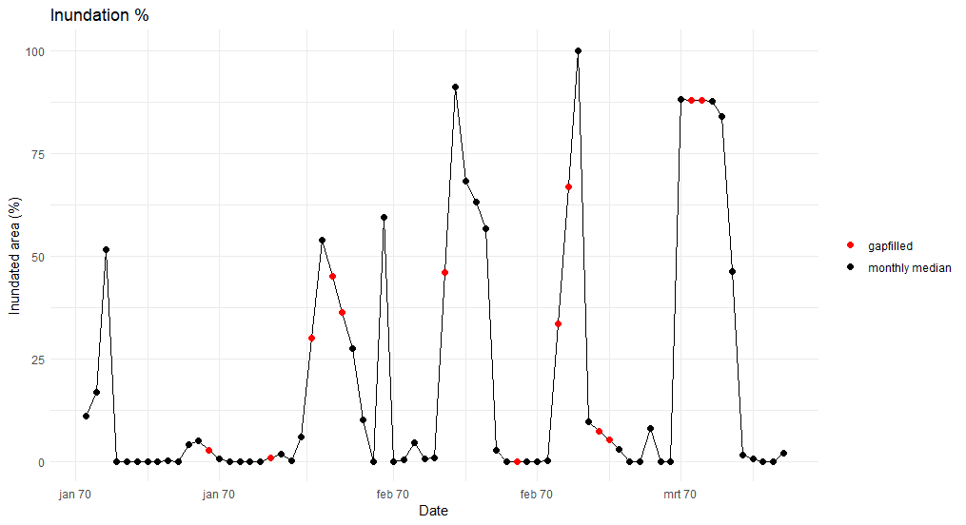
Temporal interpolation (linear)

Slide 72
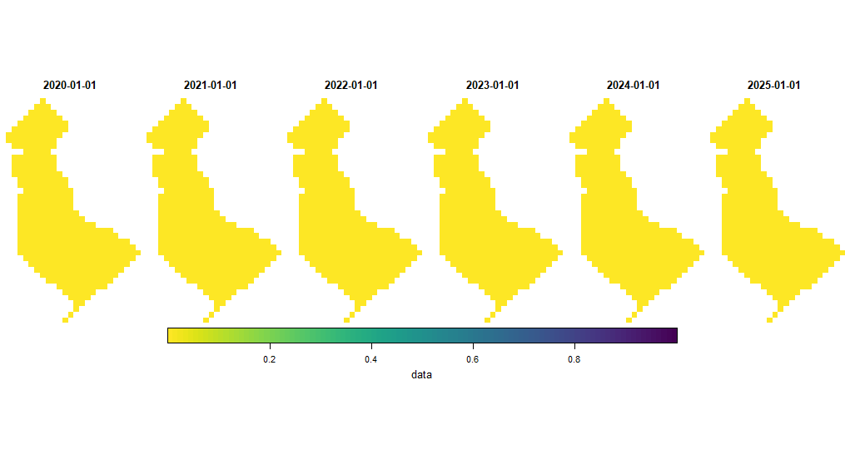
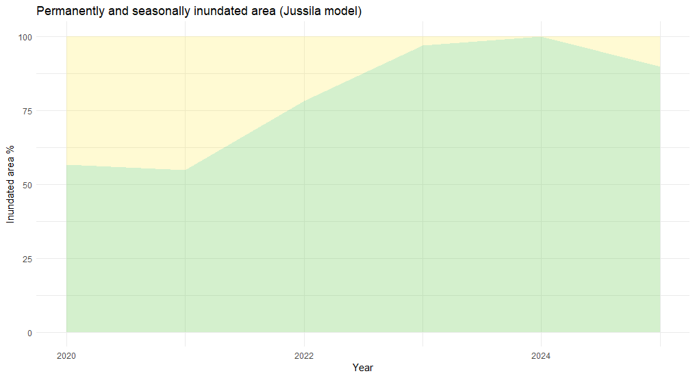
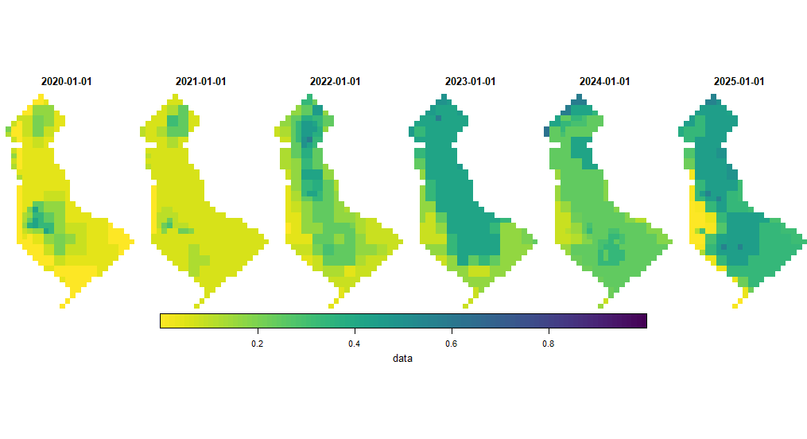
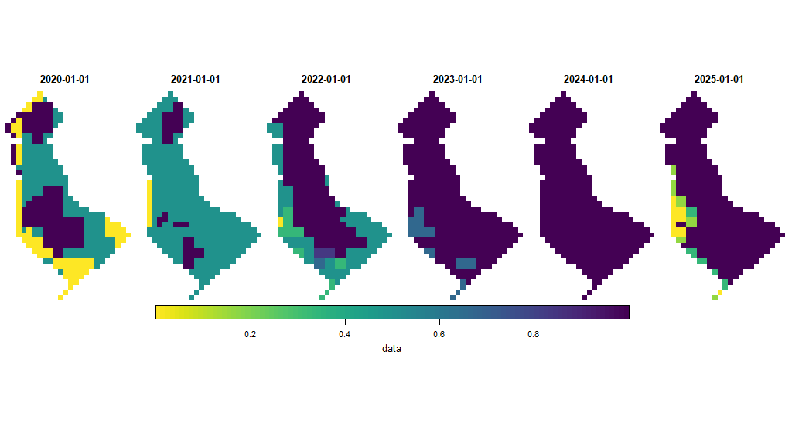
Yearly indicators
Min, mean, max values taken over the monhtly time series
No zones that are permanently inundated, but the dynamics of seasonally inundation differs between years.

